Slide 1

In theory & Practice
Machine Learning

Slide 2
What is Machine Learning?
“A machine is said to learn from experience E with respect to some class of tasks T and performance measure P if its performance at tasks in T, as measured by P, improves with experience E.”
Mitchell, Tom. (1997). Machine Learning

Slide 3
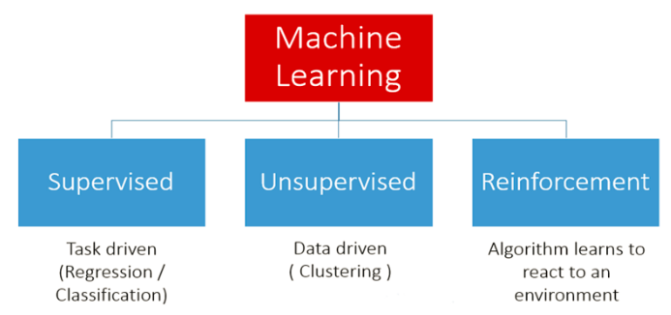
General types of Machine Learning

Slide 4
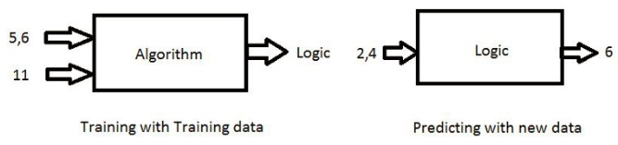
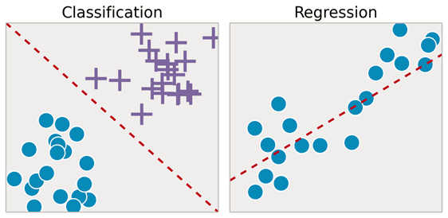
Supervised Learning

Slide 5
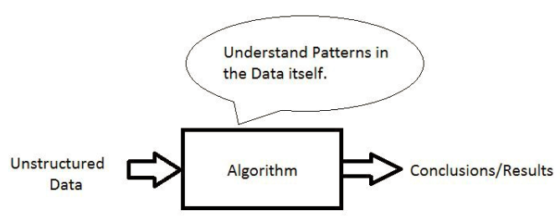
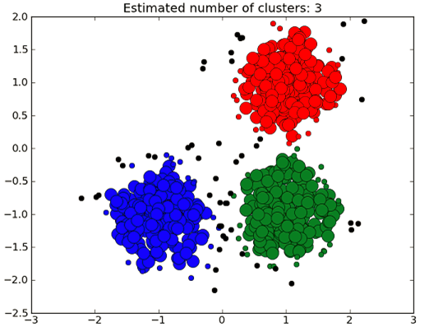
Unsupervised Learning

Slide 6
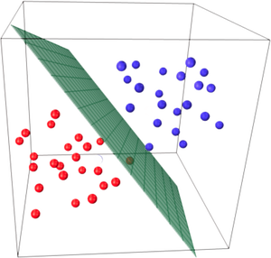
What is Logistic Regression?
Logistic regression is an avatar of the regression model and transforms the regression model into a classifier. It is not an algorithm for regression problems, where you want to predict a continuous outcome. Instead, Logistic Regression is the go-to method for binary classification. It gives you a discrete binary outcome between 0 and 1.
Survived
This is the Linear Discriminant
Dead
Note: It is always a good idea to use Logistic Regression to get to your baseline accuracy ASAP

Slide 7
Logistic Regression – The Intuition behind the model

Slide 8
Why Logistic Regression?
Incredibly easy to implement
Very efficient to train
Easily interpretable
Note: Provided the classes are linearly separable! If not, consider other workarounds. *Not in scope for today

Slide 9
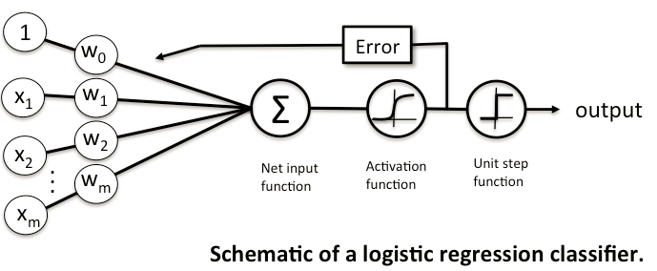
What is Logistic Regression?

Slide 10
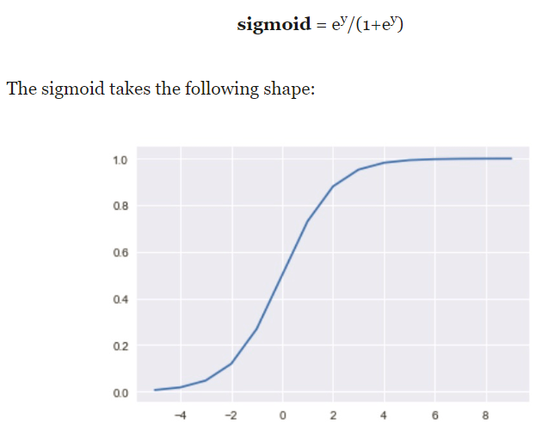
Logistic Regression – So how do we squash the LR output?

Slide 11
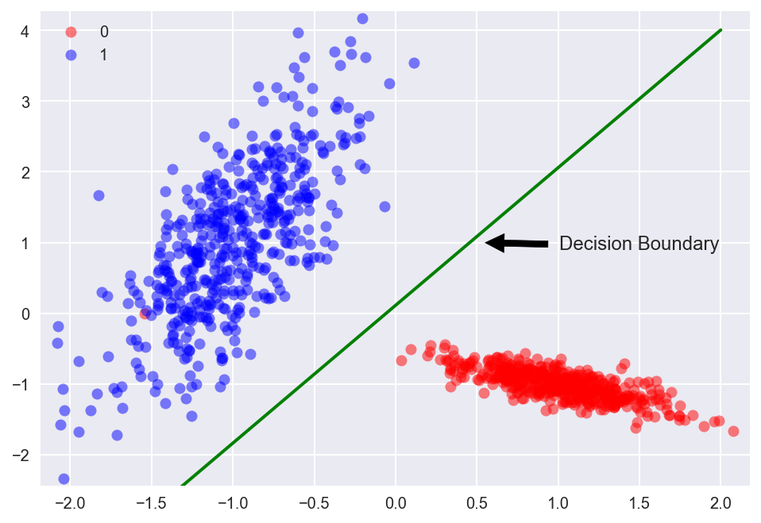
Logistic Regression – The Decision Boundary

Slide 12
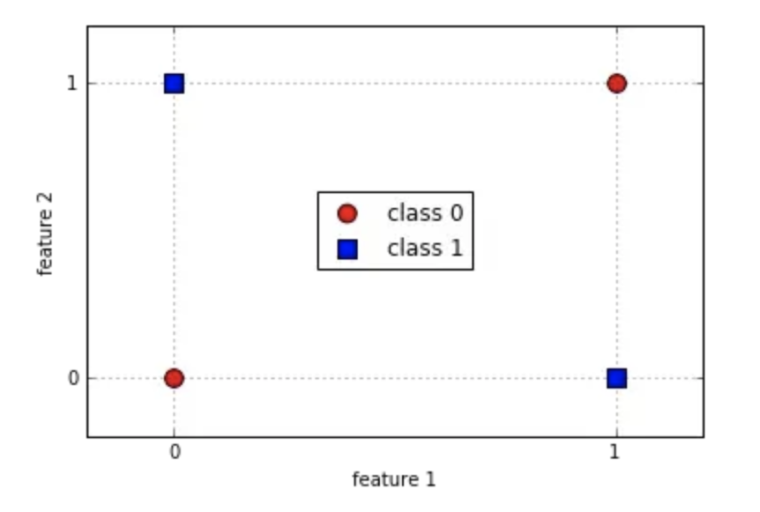
Logistic Regression – Disadvantages

Slide 13
What is a Decision Tree (ID3, C4.5, CART)?
Decision Trees (DTs) are a non-parametric supervised learning method used for classification and regression. Decision trees learn from data to approximate a sine curve with a set of if-then-else decision rules. The deeper the tree, the more complex the decision rules and the fitter the model.
Decision tree builds classification or regression models in the form of a tree structure. It breaks down a data set into smaller and smaller subsets while at the same time an associated decision tree is incrementally developed. The final result is a tree with decision nodes and leaf nodes. A decision node has two or more branches. Leaf node represents a classification or decision. The topmost decision node in a tree which corresponds to the best predictor called root node. Decision trees can handle both categorical and numerical data.

Slide 14
Why Decision Tree?
Decision tress often mimic the human level thinking so its so simple to understand the data and make some good interpretations.
Decision trees actually make you see the logic for the data to interpret (not like black box algorithms e.g. gradient boosting models, deep neural networks etc.)

Slide 15
Decision Trees – The Intuition behind the model

Slide 16
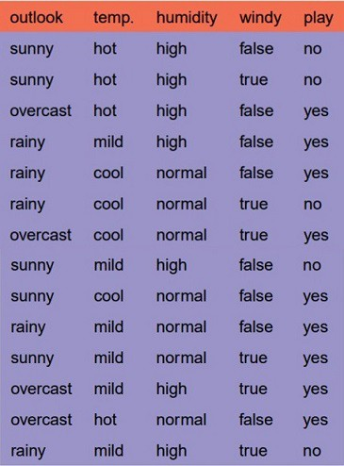
Decision Trees (ID3 Algorithm)– Worked example
Perform top-down, greedy search through the space of possible decision trees.
Best split is chosen based on the feature with the highest information gain in ID3
In order to define information gain precisely, we begin by defining a measure commonly used in information theory, called entropy that characterizes the (im)purity of an arbitrary collection of examples.

Slide 17
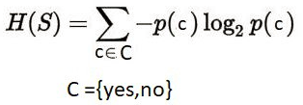
Decision Trees (ID3 Algorithm)– Worked example
So what is the metric with which we determine impurity?
Ans: Entropy

Slide 18
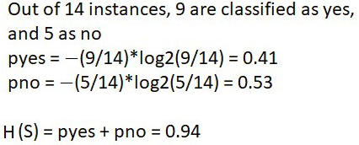
Decision Trees (ID3 Algorithm)– Worked example

Slide 19
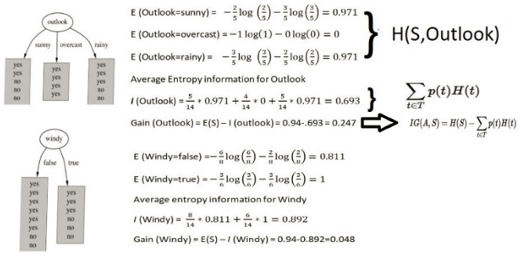
Decision Trees (ID3 Algorithm)– Worked example
Do the same for Temp and Humidity…

Slide 20
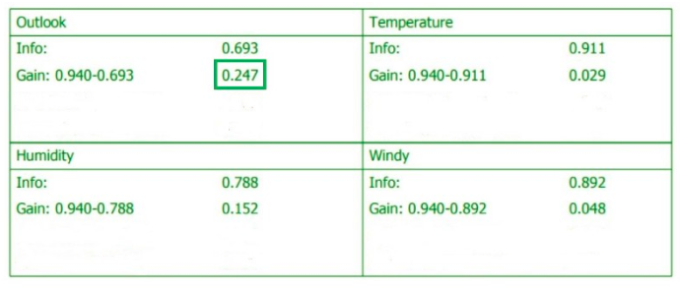
Decision Trees (ID3 Algorithm)– Worked example
Pick feature with the highest information gain.

Slide 21
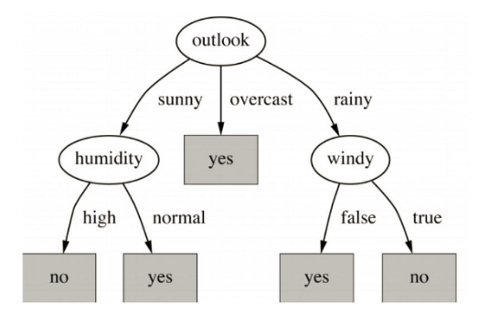
Decision Trees (ID3 Algorithm)– Worked example
Final Decision Tree will look like this

Slide 22
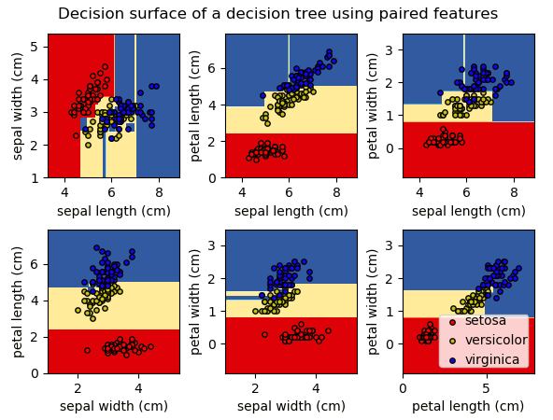
Decision Trees – The Decision Boundary

Slide 23
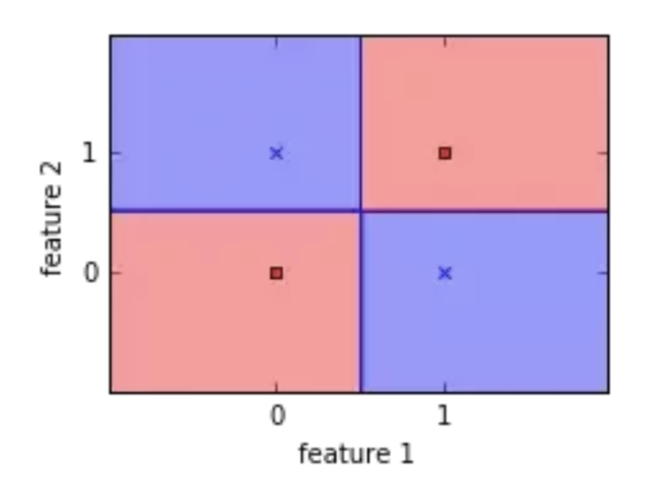
Decision Trees – The Decision Boundary

Slide 24
What are Random Forests?
The fundamental idea behind a random forest is to combine many decision trees into a single model. Individually, predictions made by decision trees (or humans) may not be accurate, but combined together, the predictions will be closer to the mark on average.
Why the name ‘random forest?’ Well, much as people might rely on different sources to make a prediction, each decision tree in the forest considers a random subset of features when forming questions and only has access to a random set of the training data points. This increases diversity in the forest leading to more robust overall predictions and the name ‘random forest.’ When it comes time to make a prediction, the random forest takes an average of all the individual decision tree estimates.

Slide 25
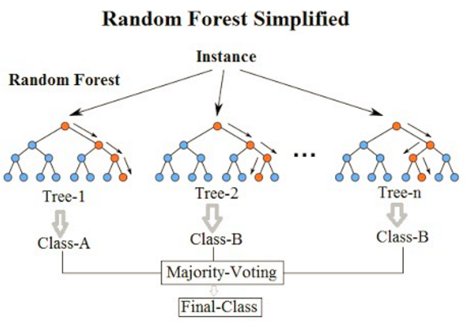
What are Random Forests?

Slide 26
Random Forest – The intuition behind the model

Slide 27
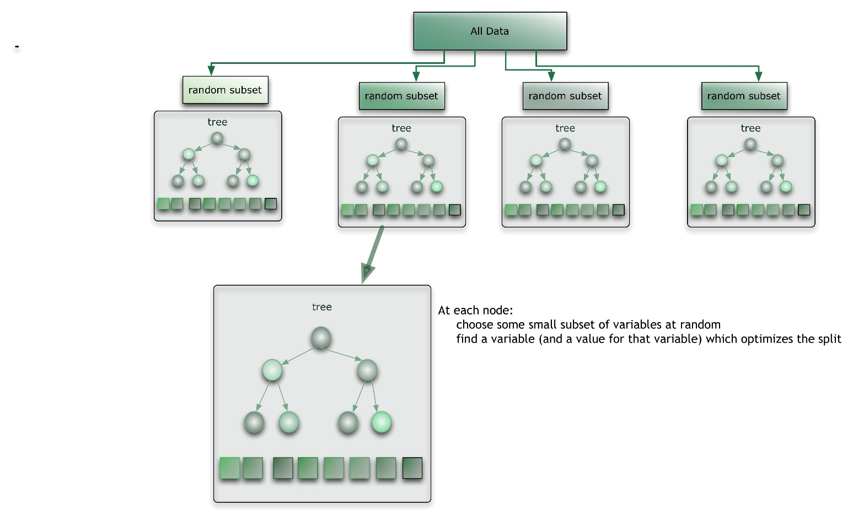
Random Forest – How does it work?

Slide 28
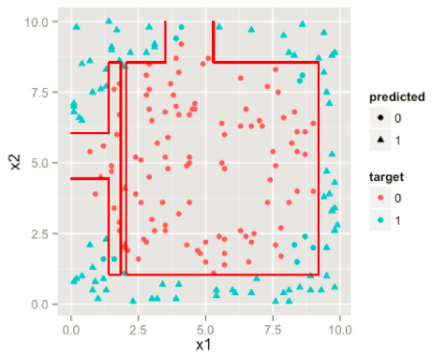
Random Forest – The Decision Boundary

Slide 29
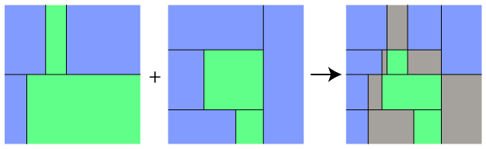
Random Forest – The Decision Boundary

Slide 30
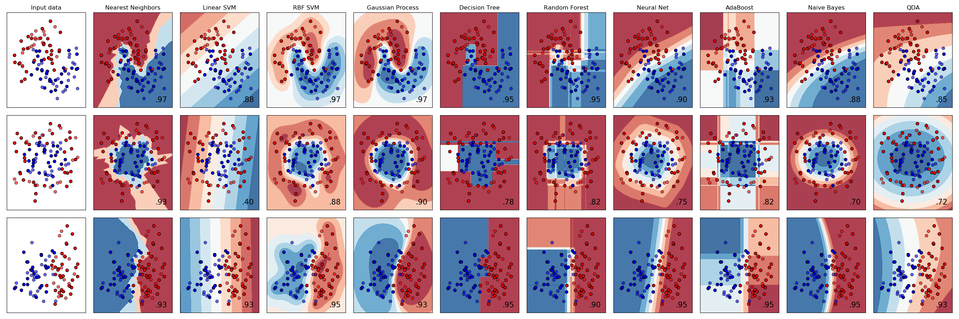
A study of decision boundaries

